Slide 1
Project on Tableau
By
Anand AL

Slide 2
Project On Tabealu
Dataset : Supermarket Store Dataset
Source : Kaggle
Details : This dataset contains sales & profit report of supermarket.
Analysis on : Tabealu

Slide 3
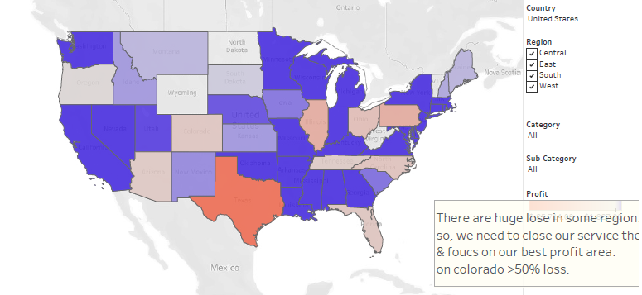
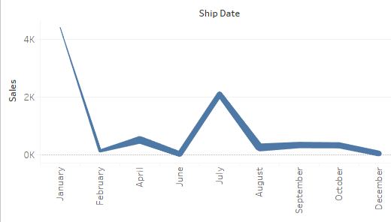
Data Analysis Report:
From the following Figure shown below, it shows that there is heavy lose on Colorado & sales is gradually decreasing in that place

Slide 4
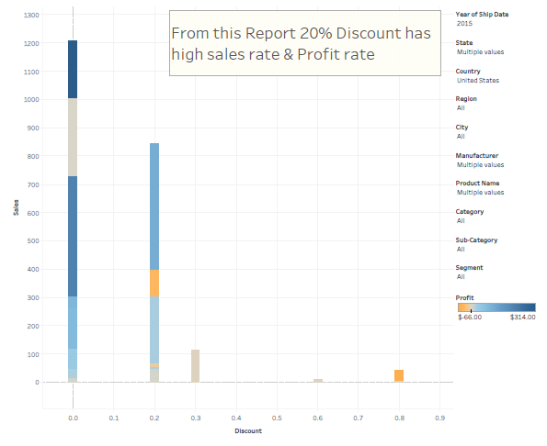
Sales Vs Discount
Sales is highly Improved when we give offer for 20%. It also provide good amount of profit. Most of our customer prefer it.

Slide 5
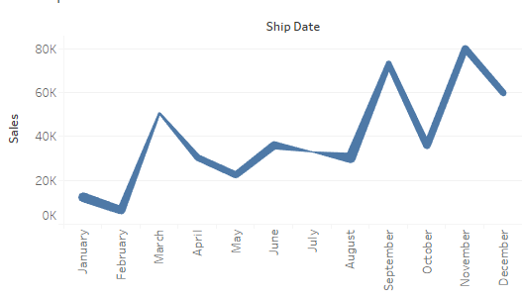
Sales Vs Time
From figure shown below, overall sales in September month & December month is high in all year

Slide 6
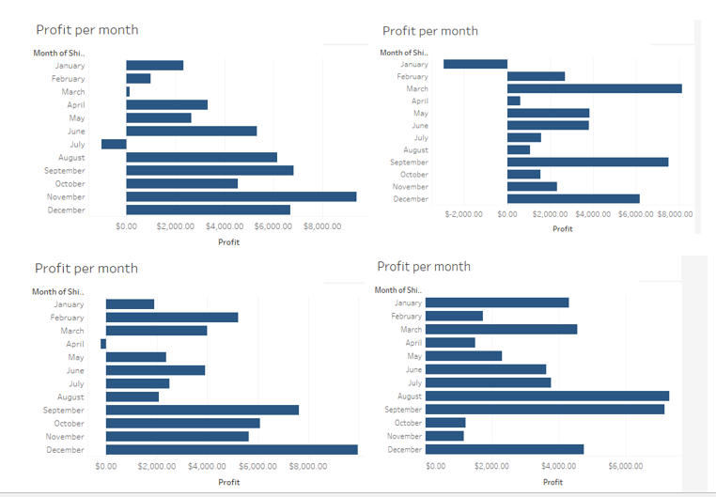
Profit Vs Time Period
Profit is gradually increasing over a period of time.
Currently our profit is about 15% on Avg.
Without considering our shop in Colorado, our profit is 16% on Avg.

Slide 7
Thank You
Here is my Link to My work on
Tabelau :- Click Here

